Slide 1
Section 1.5
Solving Inequalities
Copyright © 2012 Pearson Education, Inc. Publishing as Prentice Hall.

Slide 2

Copyright © 2012 Pearson Education, Inc. Publishing as Prentice Hall.

Slide 3

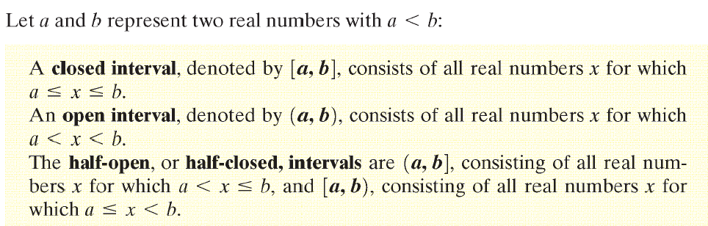
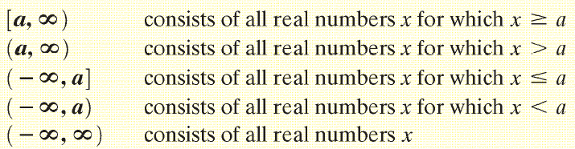
Copyright © 2012 Pearson Education, Inc. Publishing as Prentice Hall.

Slide 4
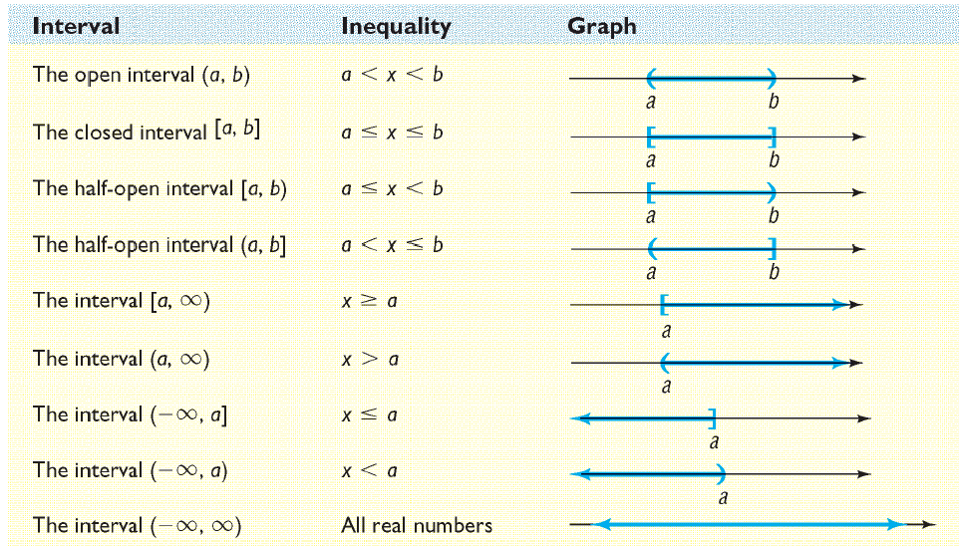
Copyright © 2012 Pearson Education, Inc. Publishing as Prentice Hall.

Slide 5

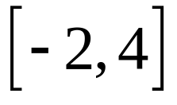
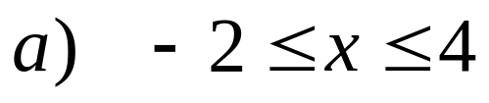
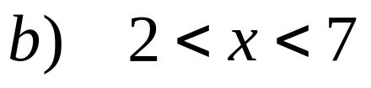
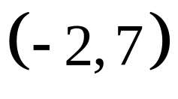
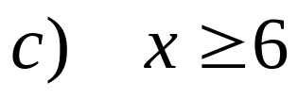
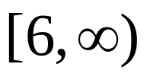
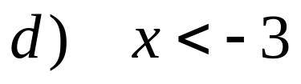
Write each inequality using interval notation:
Copyright © 2012 Pearson Education, Inc. Publishing as Prentice Hall.

Slide 6
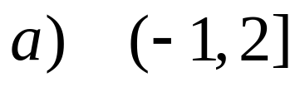

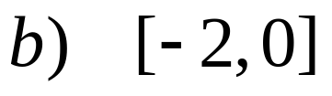

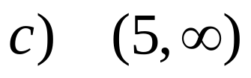

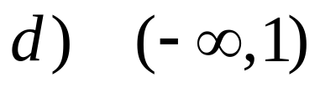

Write each interval as an inequality involving x.
Copyright © 2012 Pearson Education, Inc. Publishing as Prentice Hall.

Slide 7

Copyright © 2012 Pearson Education, Inc. Publishing as Prentice Hall.

Slide 8
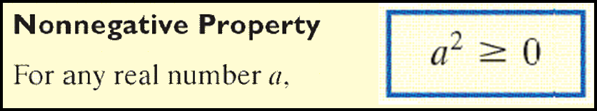
Copyright © 2012 Pearson Education, Inc. Publishing as Prentice Hall.

Slide 9
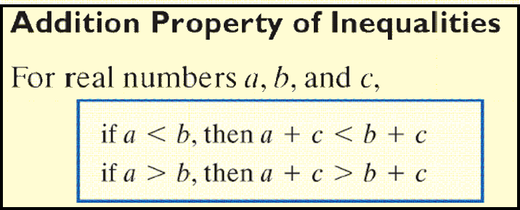
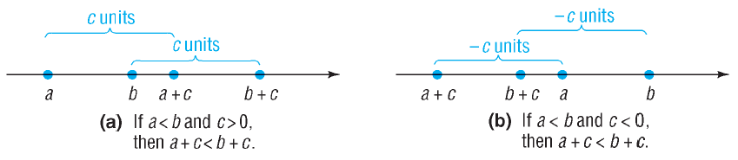
Copyright © 2012 Pearson Education, Inc. Publishing as Prentice Hall.

Slide 10

Copyright © 2012 Pearson Education, Inc. Publishing as Prentice Hall.

Slide 11
Express as an inequality the result of multiplying each side of the inequality 3 < 5 by 2.
3(2) < 5(2)
6 < 10
Copyright © 2012 Pearson Education, Inc. Publishing as Prentice Hall.

Slide 12
Express as an inequality the result of multiplying each side of the inequality 3 < 5 by – 2.
3(– 2) ? 5(– 2)
– 6 > – 10
Note to keep this inequality true, the inequality symbol must be reversed.
Copyright © 2012 Pearson Education, Inc. Publishing as Prentice Hall.

Slide 13
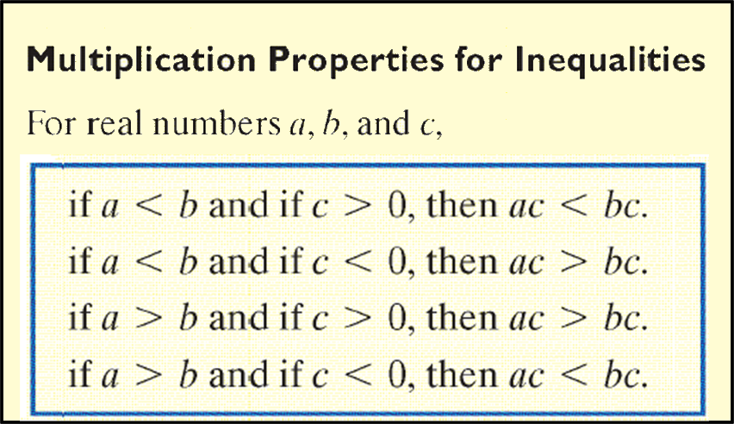
Copyright © 2012 Pearson Education, Inc. Publishing as Prentice Hall.

Slide 14
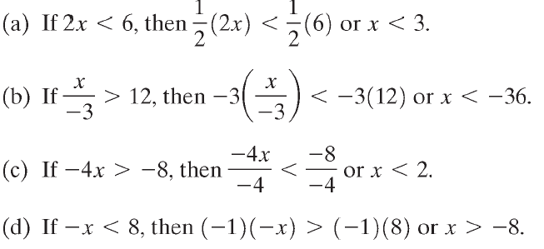
Copyright © 2012 Pearson Education, Inc. Publishing as Prentice Hall.

Slide 15
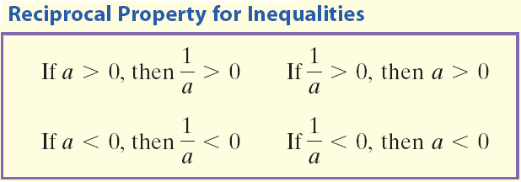
Copyright © 2012 Pearson Education, Inc. Publishing as Prentice Hall.

Slide 16

Copyright © 2012 Pearson Education, Inc. Publishing as Prentice Hall.

Slide 17
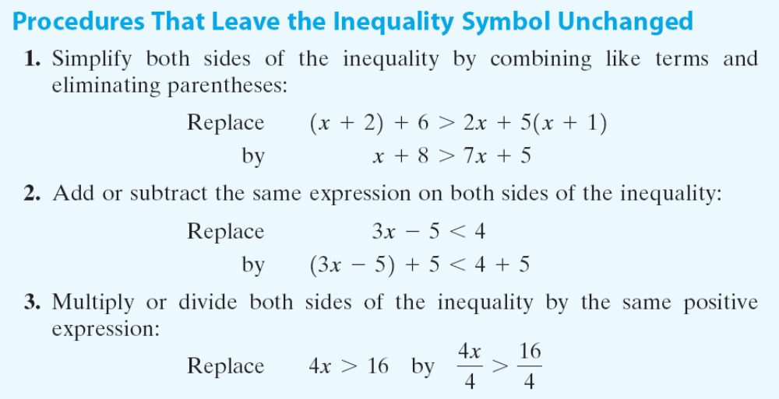
Copyright © 2012 Pearson Education, Inc. Publishing as Prentice Hall.

Slide 18
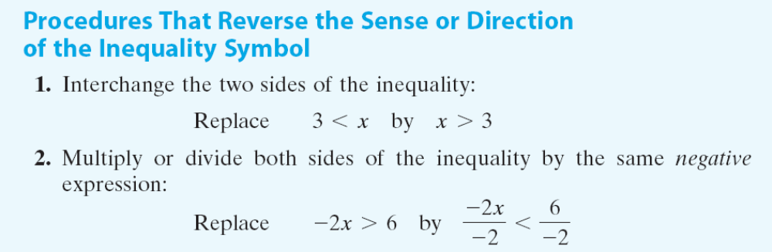
Copyright © 2012 Pearson Education, Inc. Publishing as Prentice Hall.

Slide 19


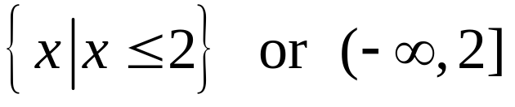

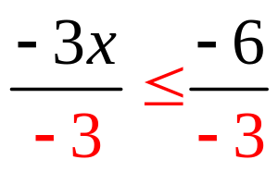
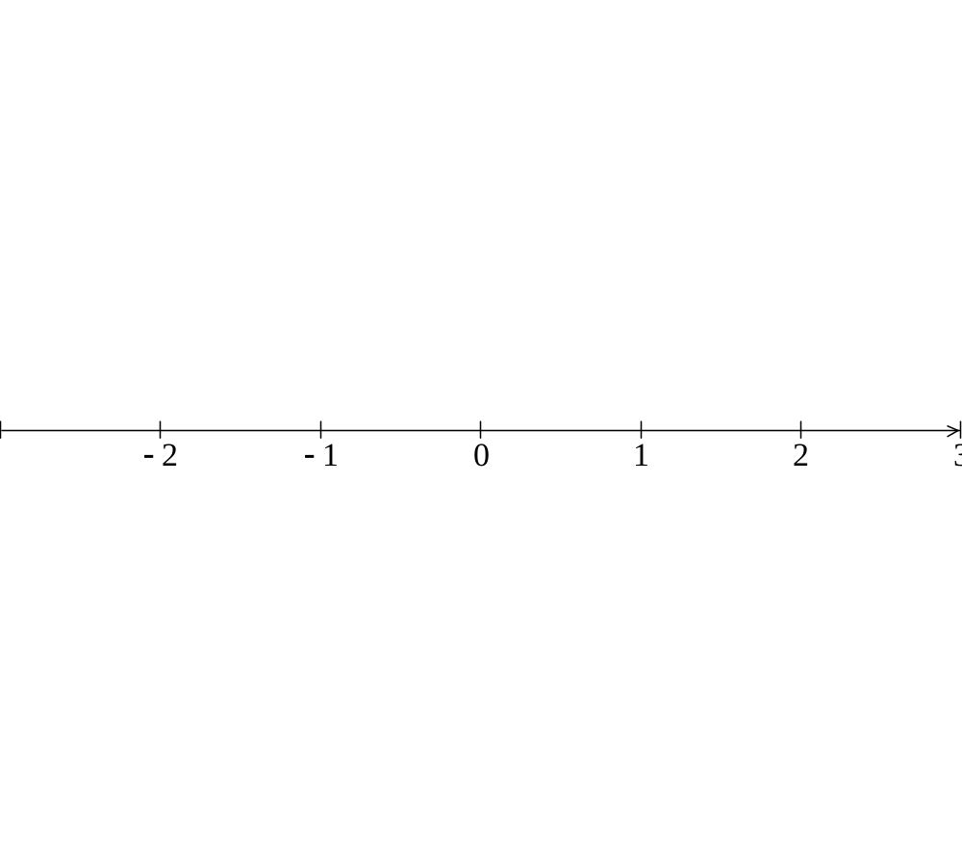

]
Copyright © 2012 Pearson Education, Inc. Publishing as Prentice Hall.

Slide 20

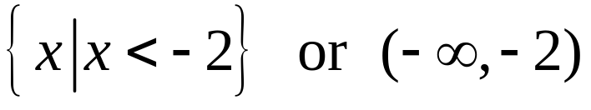



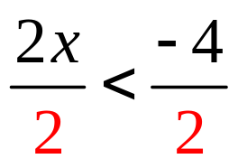

)
Copyright © 2012 Pearson Education, Inc. Publishing as Prentice Hall.

Slide 21

Copyright © 2012 Pearson Education, Inc. Publishing as Prentice Hall.

Slide 22





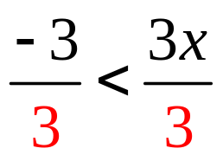
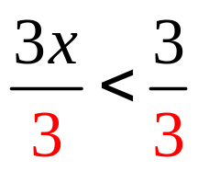


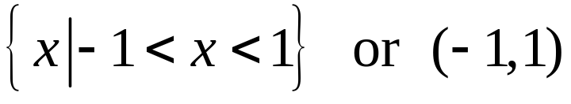
(
)
Copyright © 2012 Pearson Education, Inc. Publishing as Prentice Hall.

Slide 23
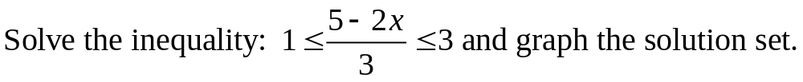
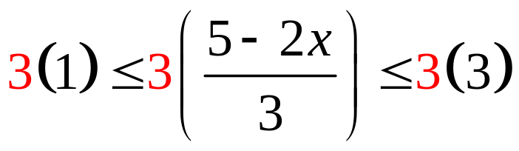
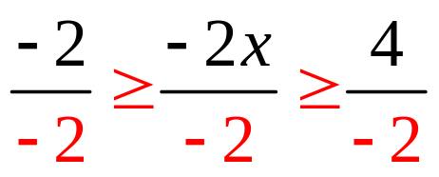





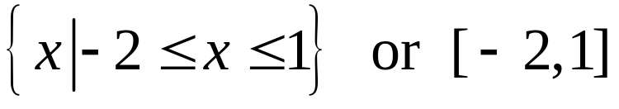
[
]
Copyright © 2012 Pearson Education, Inc. Publishing as Prentice Hall.

Slide 24
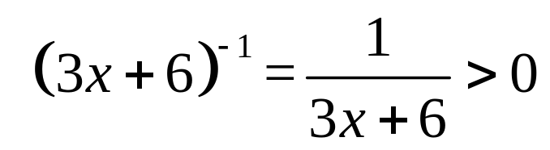

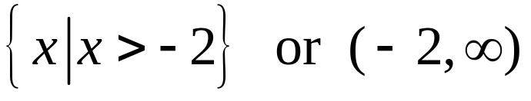

(
Copyright © 2012 Pearson Education, Inc. Publishing as Prentice Hall.

Slide 25

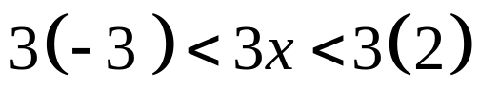




Copyright © 2012 Pearson Education, Inc. Publishing as Prentice Hall.

Slide 26


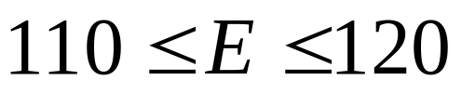
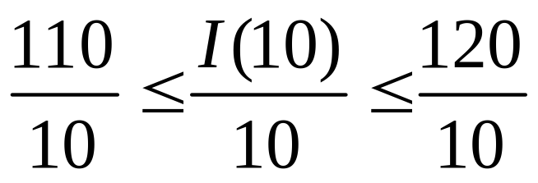
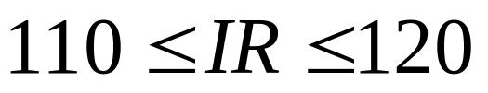
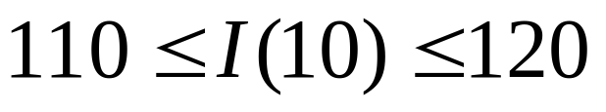

In electricity, Ohm’s law states that E = IR, where E is the voltage (in volts). I is the current (in amperes), and R is the resistance (in ohms). An air-conditioning unit is rated at a resistance of 10 ohms. If the voltage varies from 110 to 120 volts, inclusive, what corresponding range of current will the air conditioner draw?
The air conditioner will draw between 11 and 12 amperes of current, inclusive.
Copyright © 2012 Pearson Education, Inc. Publishing as Prentice Hall.

